Slide 1
The Privilege of border blindness: Transnational (Im)mobility in Aléa Torik’s The Noise of Becoming and Abbas Khider’s The Village Indian
Nicole Coleman, Assistant Professor of German
Humanities Center’s 2017 Faculty Fellows Conference

Slide 2


Slide 3

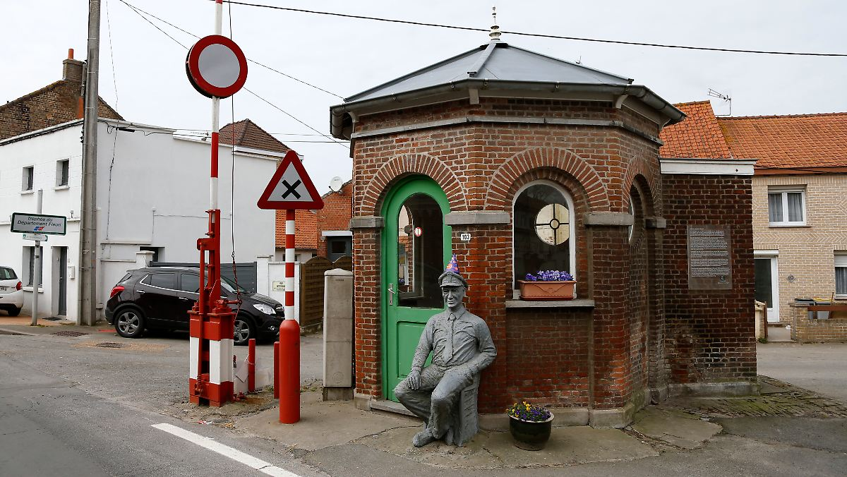
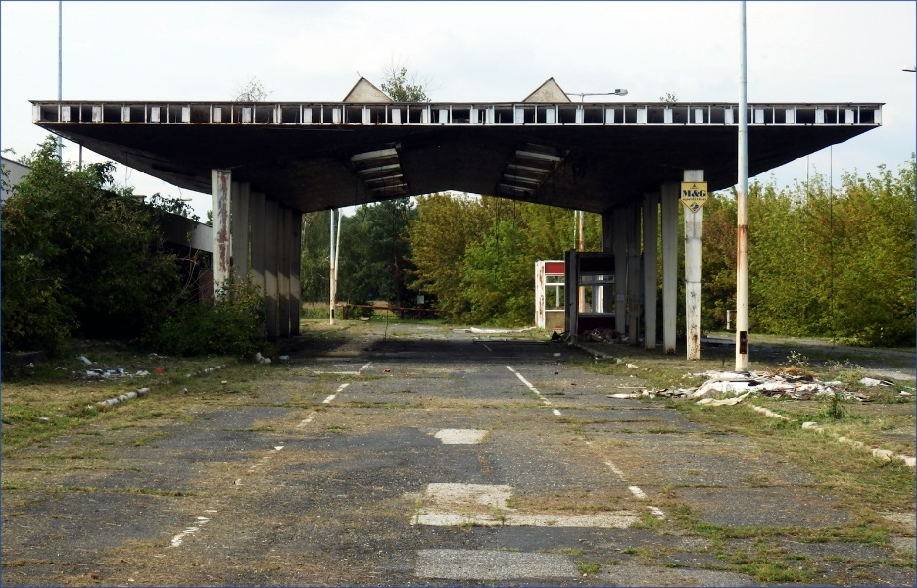

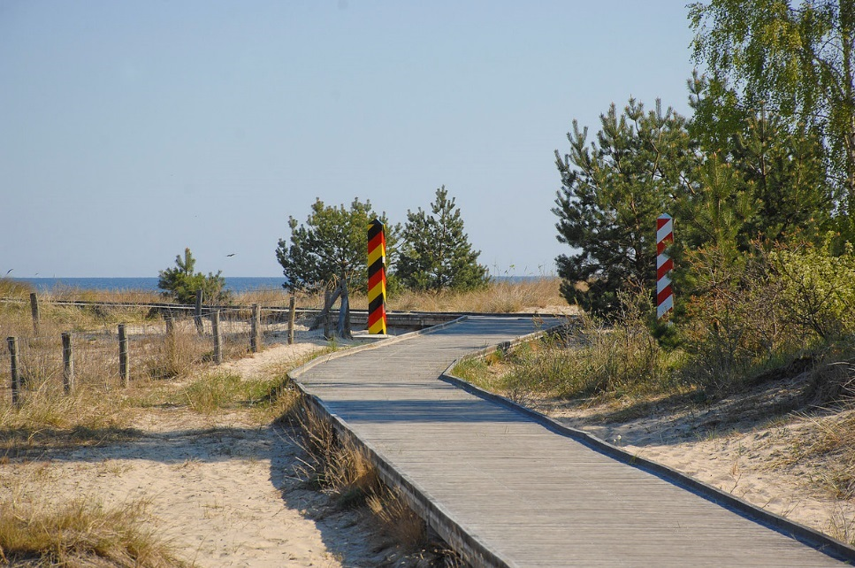
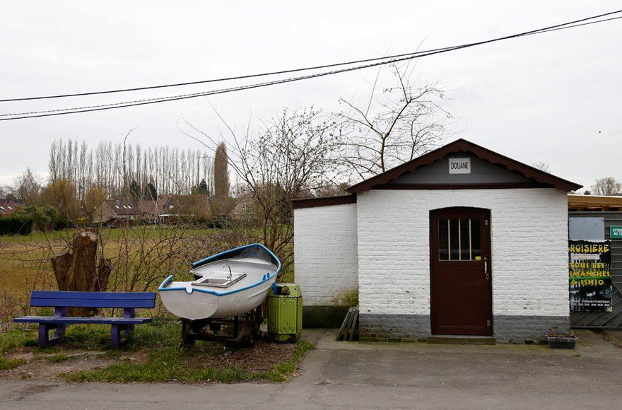
Borderless Europe – Uninhibited Mobility?

Slide 4






Fortress Europe – Precarious (Im)Mobility

Slide 5
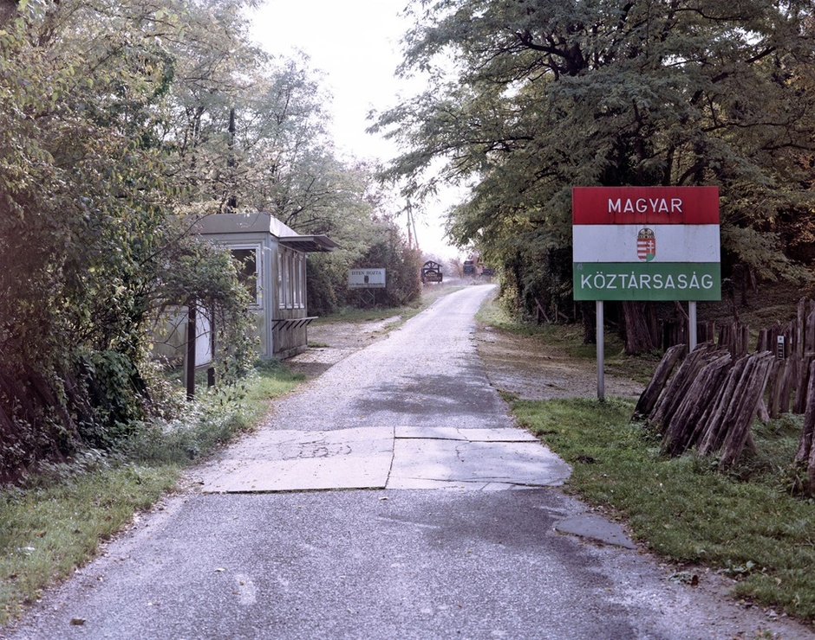
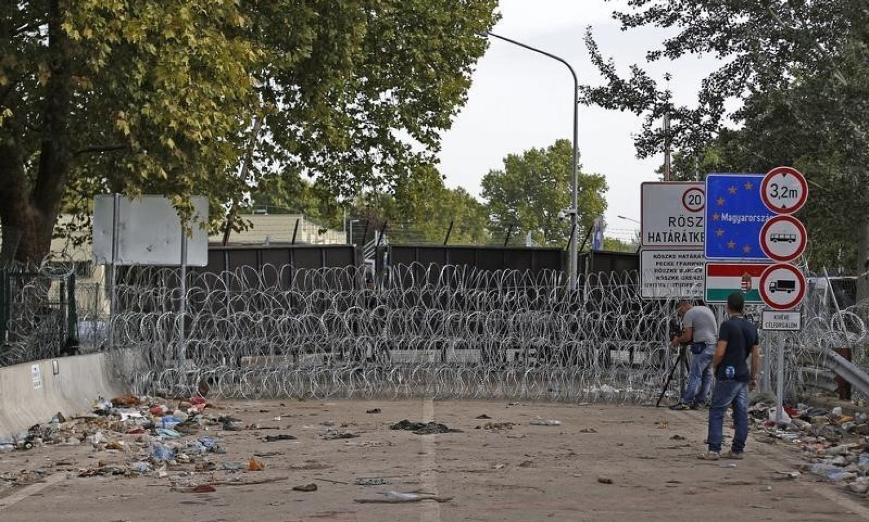
Idealist Transnational Literature
Aléa Torik: The Noise of Becoming (2012)
Realist Transnational Literature
Abbas Khider: The Village Indian (2008)

Slide 6
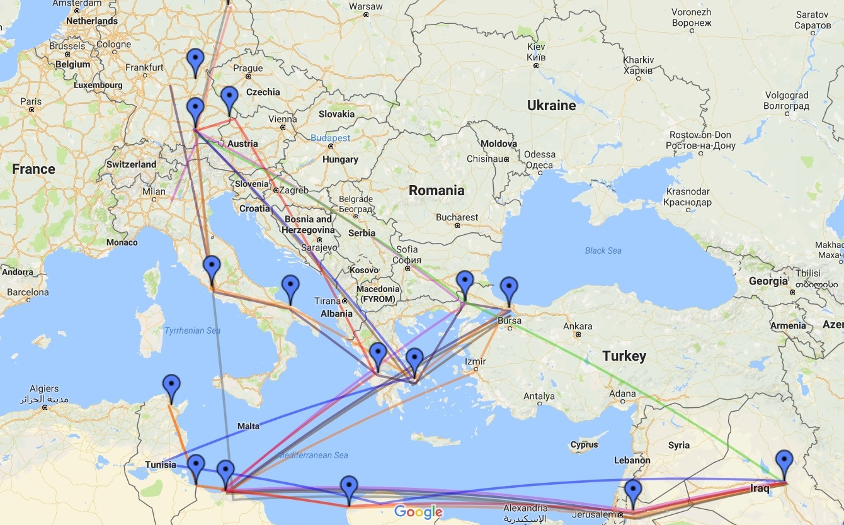

Slide 7
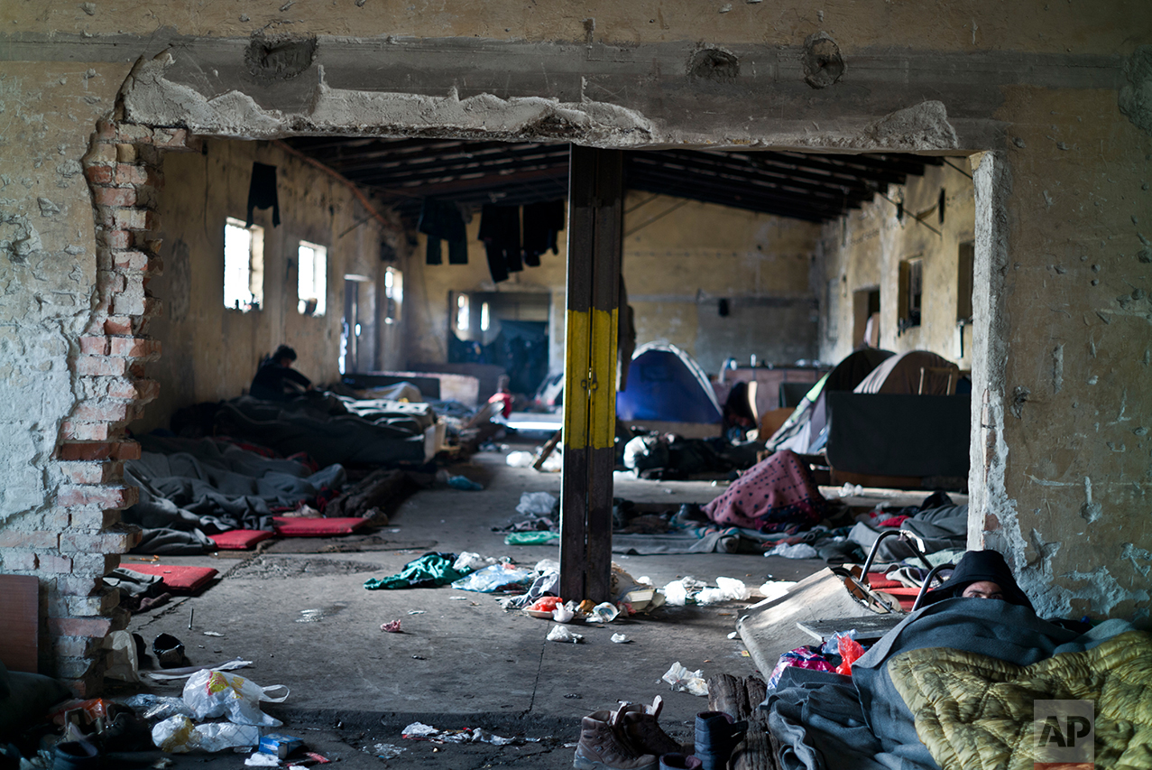
Invisible Borders – The social Space of Refugees

Slide 8
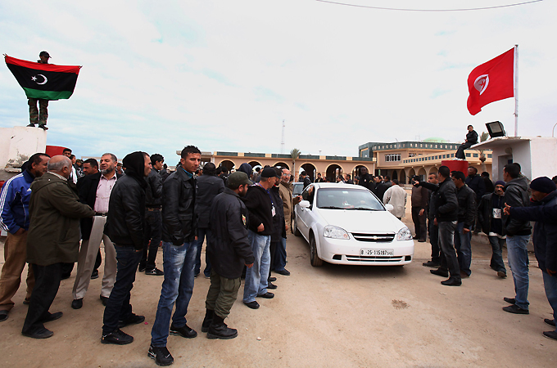
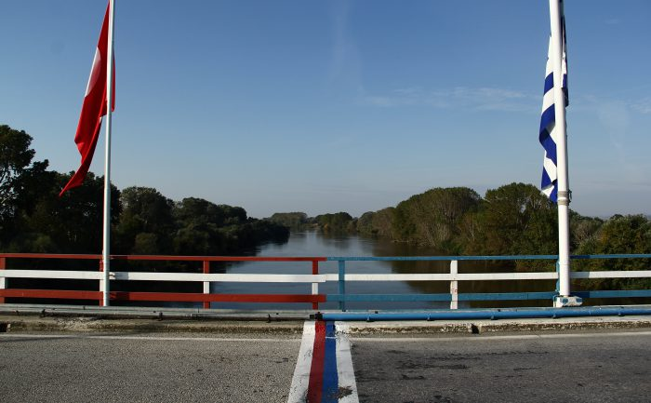
Material Borders

Slide 9
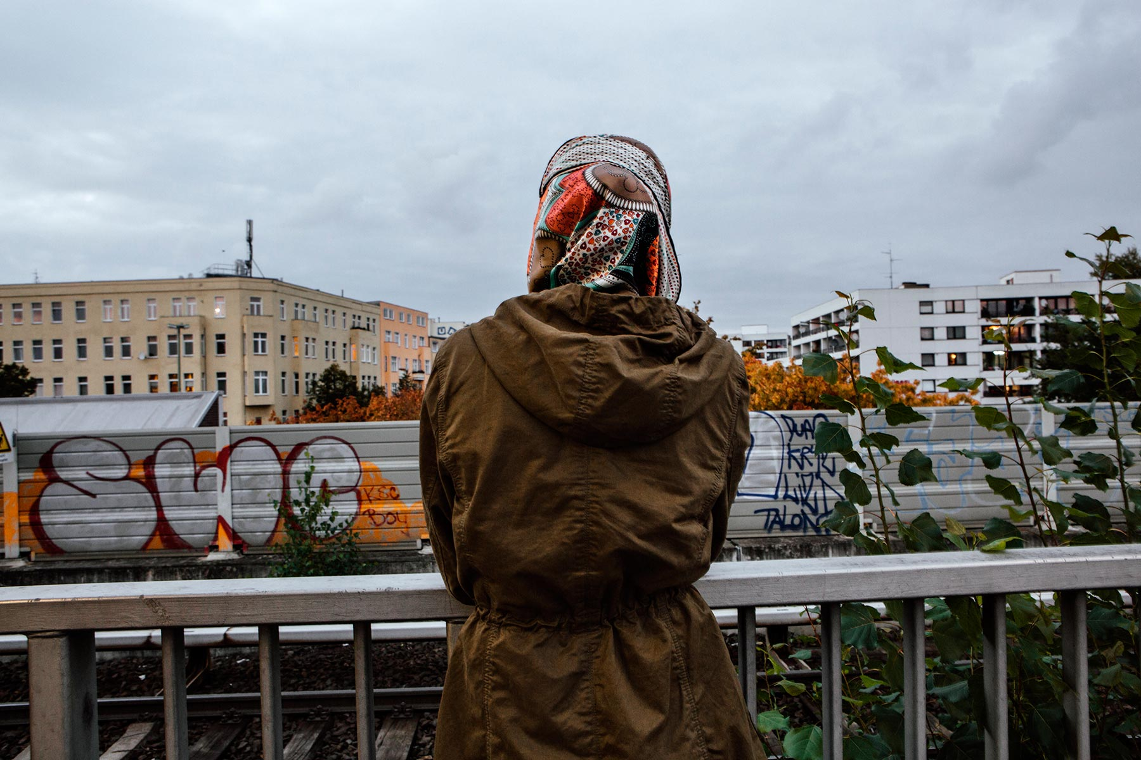
Asylum – Security and Immobility

Slide 10
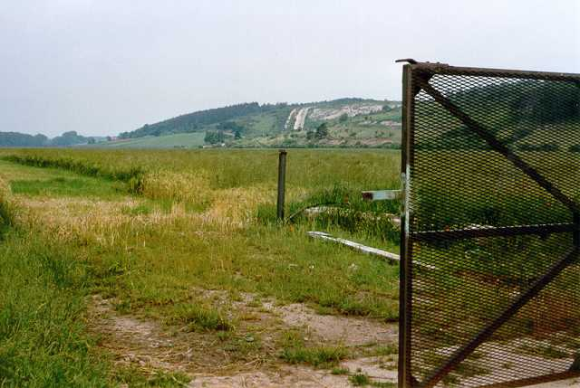
The Privilege of Border Blindness

